Slide 1
License Plate Recognition Using Image opencv and pytesseract
Project Group Members:-
Akaash V.R. 119A2006
Darshan Sonawane 119A2012
Anushka Sur 119A2008
Dhruv R Suvarna 119A2015

Slide 2
Objective of the project:-
this project aims to recognize license number plates.
In order to detect license number plates, we will use
OpenCV to identify number plates from the images uploaded.
Python pytesseract to extract characters and digits from the number plates.

Slide 3
Details of Dataset:-
The dataset given to input includes a folder consisting of 100 car images.
The dataset stored in the output includes the total number of license plates detected with their date, day and time provided respectively.

Slide 4
Data Preprocessing:-
For processing the Image as accurately as possible , we need to convert the image to grey scale.
Now , we need to smoothen the image but we simultaneously need to make sure that the edges are intact. There is a function in OpenCV that does just that: cv2.bilateralFilter(img, d, sigmaColor1, sigmaColor2) where d is the diameter of each pixel around it.
With the help of Canny in OpenCV, we can easily detect edges from the image. This happens with the help of difference of BGR around the given pixels.

Slide 5
Now that we have the edges , let’s convert them into contours (Contour are basically line joining all the points along the boundary of an image that are having the same intensity). This is implemented by findContours() function which takes edges as argument. And also if we have to find the contour of a straight line. We need just two endpoints of that line. This is what cv2.CHAIN_APPROX_SIMPLE does. It removes all redundant points and compresses the contour, thereby saving memory.
As we can clearly see the contours, let’s plot them on to our image using drawContours(). All we have to do here is pass -1 in 2nd parameter to indicate that we want to draw all the detected contours:_ = cv2.drawContours(image_copy, cnts, -1, 55 ,0)

Slide 6
count =0
For c in cnts
peri = cv2.arcLength(c, True)
approx = cv2.approxPolyDP(c, 0.02 * perimeter, True)
if len(approx) == 4:
NumberPlateCnt = approx.
Character Segmentation: It’s at this stage the characters on the license plate are mapped out and segmented into cropped image.The coordinates of the Contours are now stored and all we need to do is crop the image with the stored coordinates and VOILA! we have the number plate.

Slide 7
Character Recognition: This is where we wrap things up. The characters earlier segmented are identified here. We also need to extract the text from the image which is supported by pytesseract :text = p.image_to_string(plate, lang=”eng”)
Next we will be storing data of licence plate with date,day and time in data.csv
df = pd.DataFrame(raw_data)
df.to_csv('data.csv',mode='a’)
print("Detected Number is: ",text)

Slide 8
Methodology
OpenCV
Pytesseract
It is an open-source machine learning library and provides a common infrastructure for computer vision.
Pytesseract is a Tesseract-OCR Engine to read image types and extract the information present in the image.

Slide 9
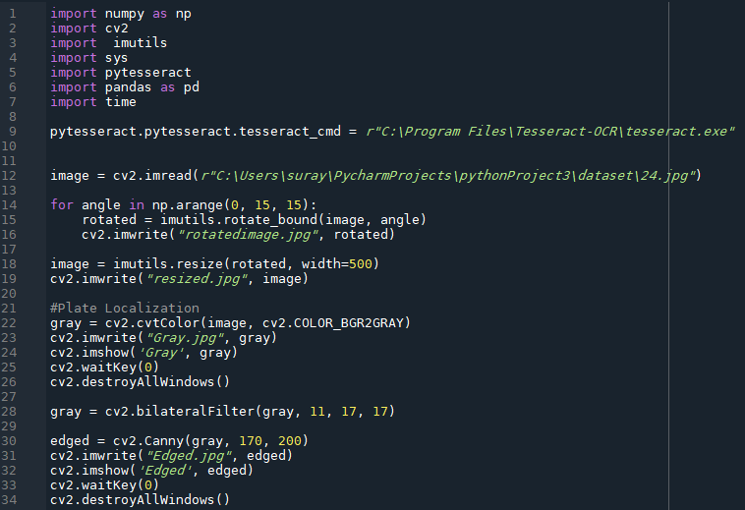
Implementation:-

Slide 10
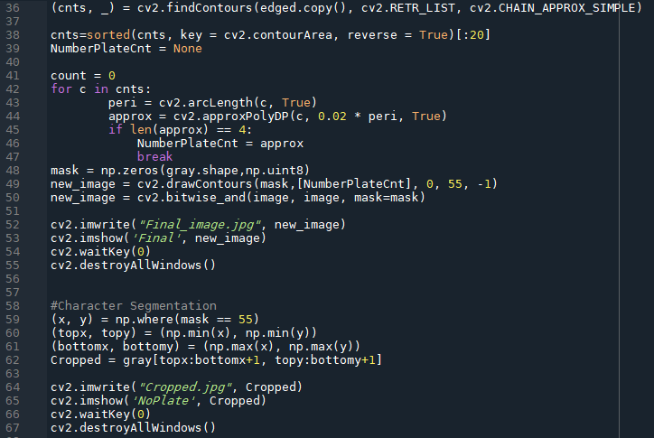

Slide 11
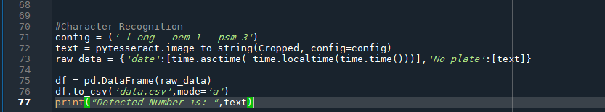

Slide 12
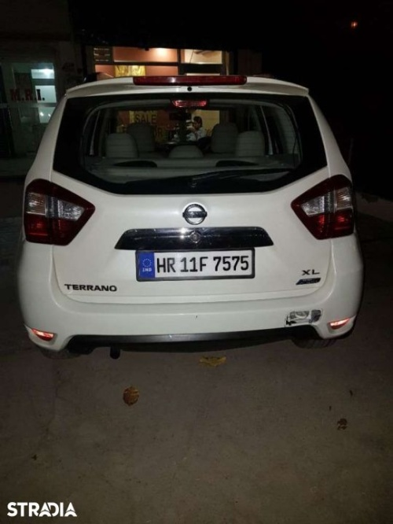
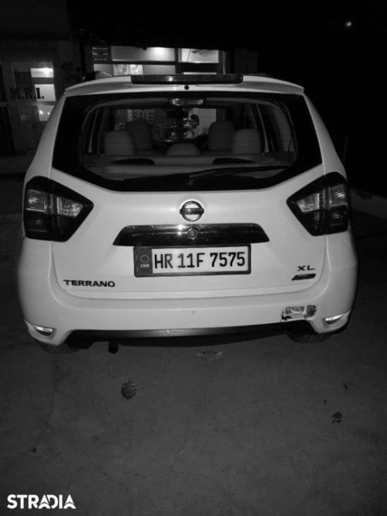
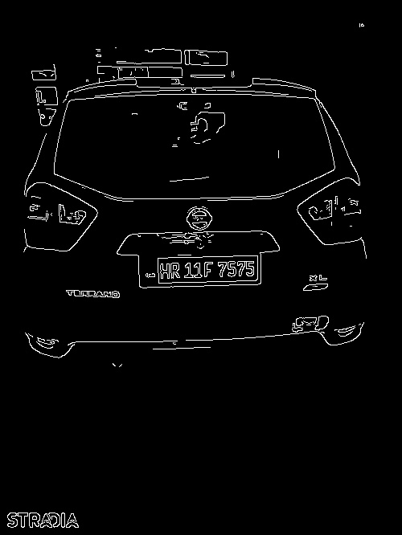
Results/Output:-

Slide 13
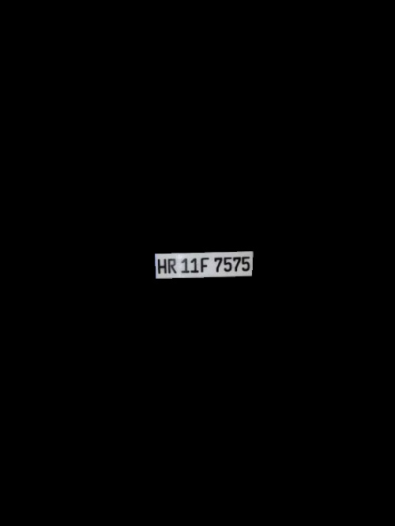

Result/Output:-

Slide 14
Conclusion
Hence with the help of this project, we have finally understood the concept of image processing with the help of opencv and pytesseract and hence we also saw the application regarding with the project.
THANK-YOU

